Slide 1

New York City Bike sharing program
Abhinay Imandi Ryan Kozlowski Adam Olderr Everardo Marquez Krithin Venkatesh
Team Lead Email
z1856513@students.niu.edu

Slide 2
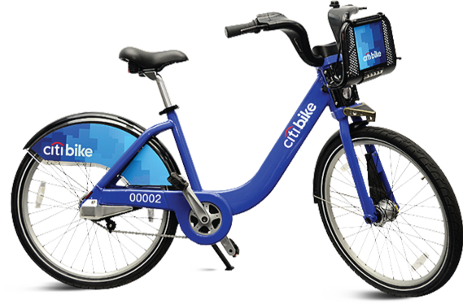
NYC & CitiBike Background
New York city is the largest city in America with a population of approximately 8.623 million people
NYCDOT says that 56% of all automobile trips are under 3 miles in distance, and 22% are under 1 mile
The citiBike program began on May 23, 2013 with 6000 bikes across 332 stations
citiBike is operated by Motivate, the global leader in bike share. A full-service bike share operator and technology innovator
Bike share was created to reduce emissions, road wear, collisions, traffic congestion, public health
As of May 2018 citiBike has 12,000 bikes, 750 stations in 60 neighborhoods with over 143,000 members and over 70 million rides taken.

Slide 3
Story
Growth of CitiBike in New York Through the years
Average usage of bikes
Most popular bike stations in the city and where they are located
Assumptions on usage of bikes and behavior

Slide 4
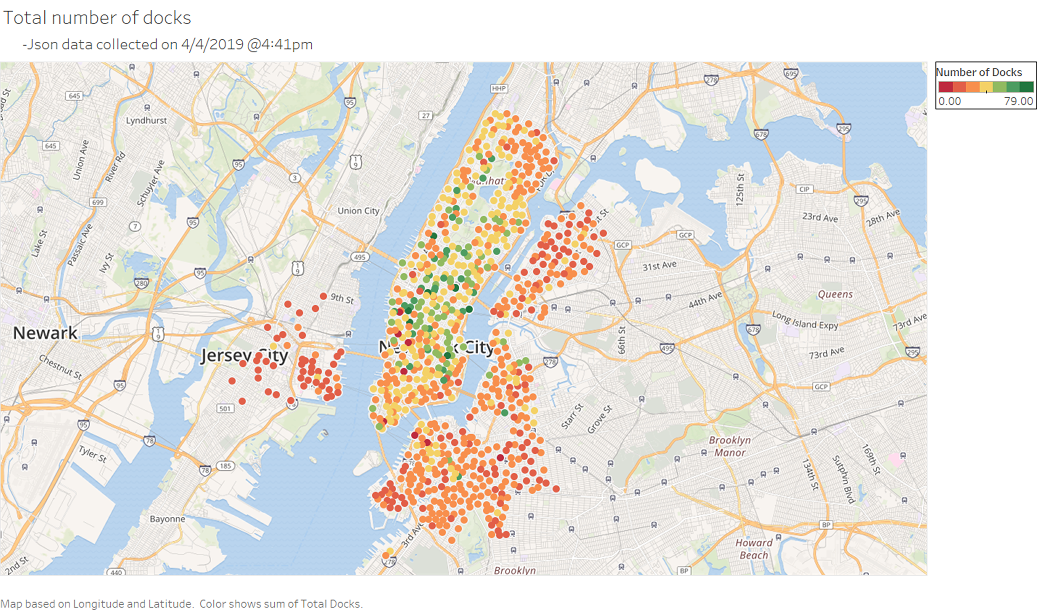
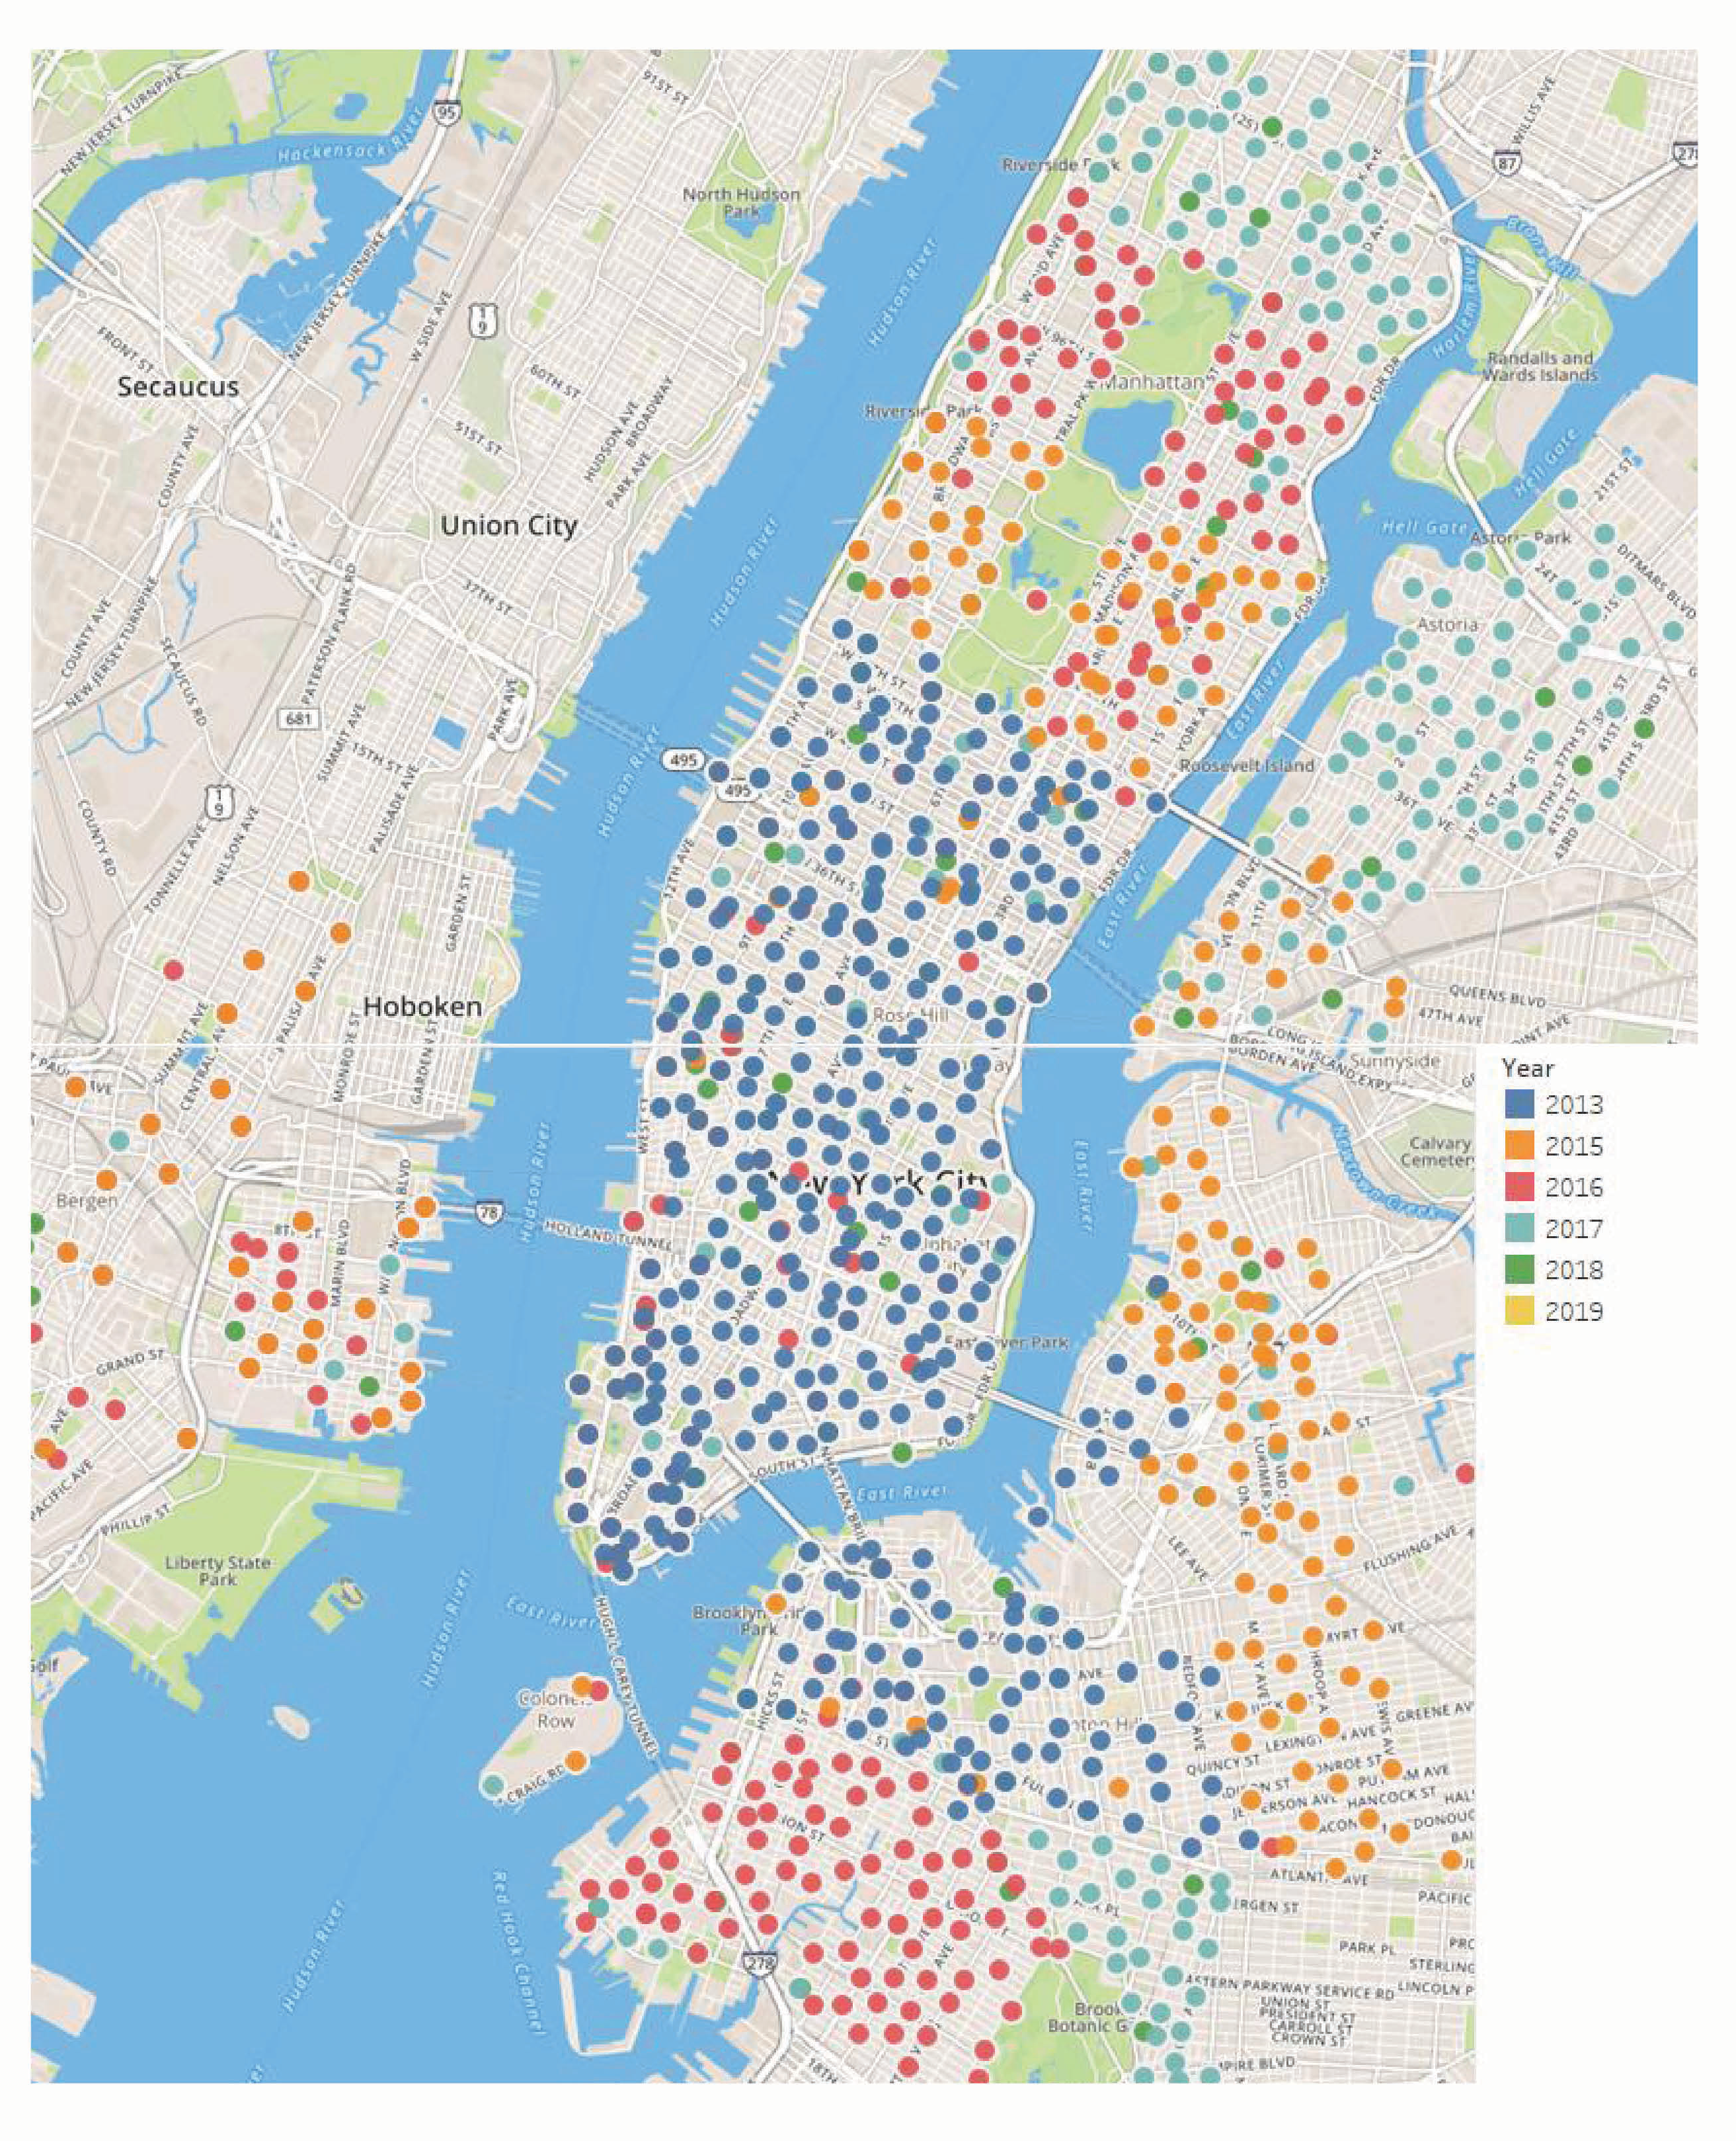
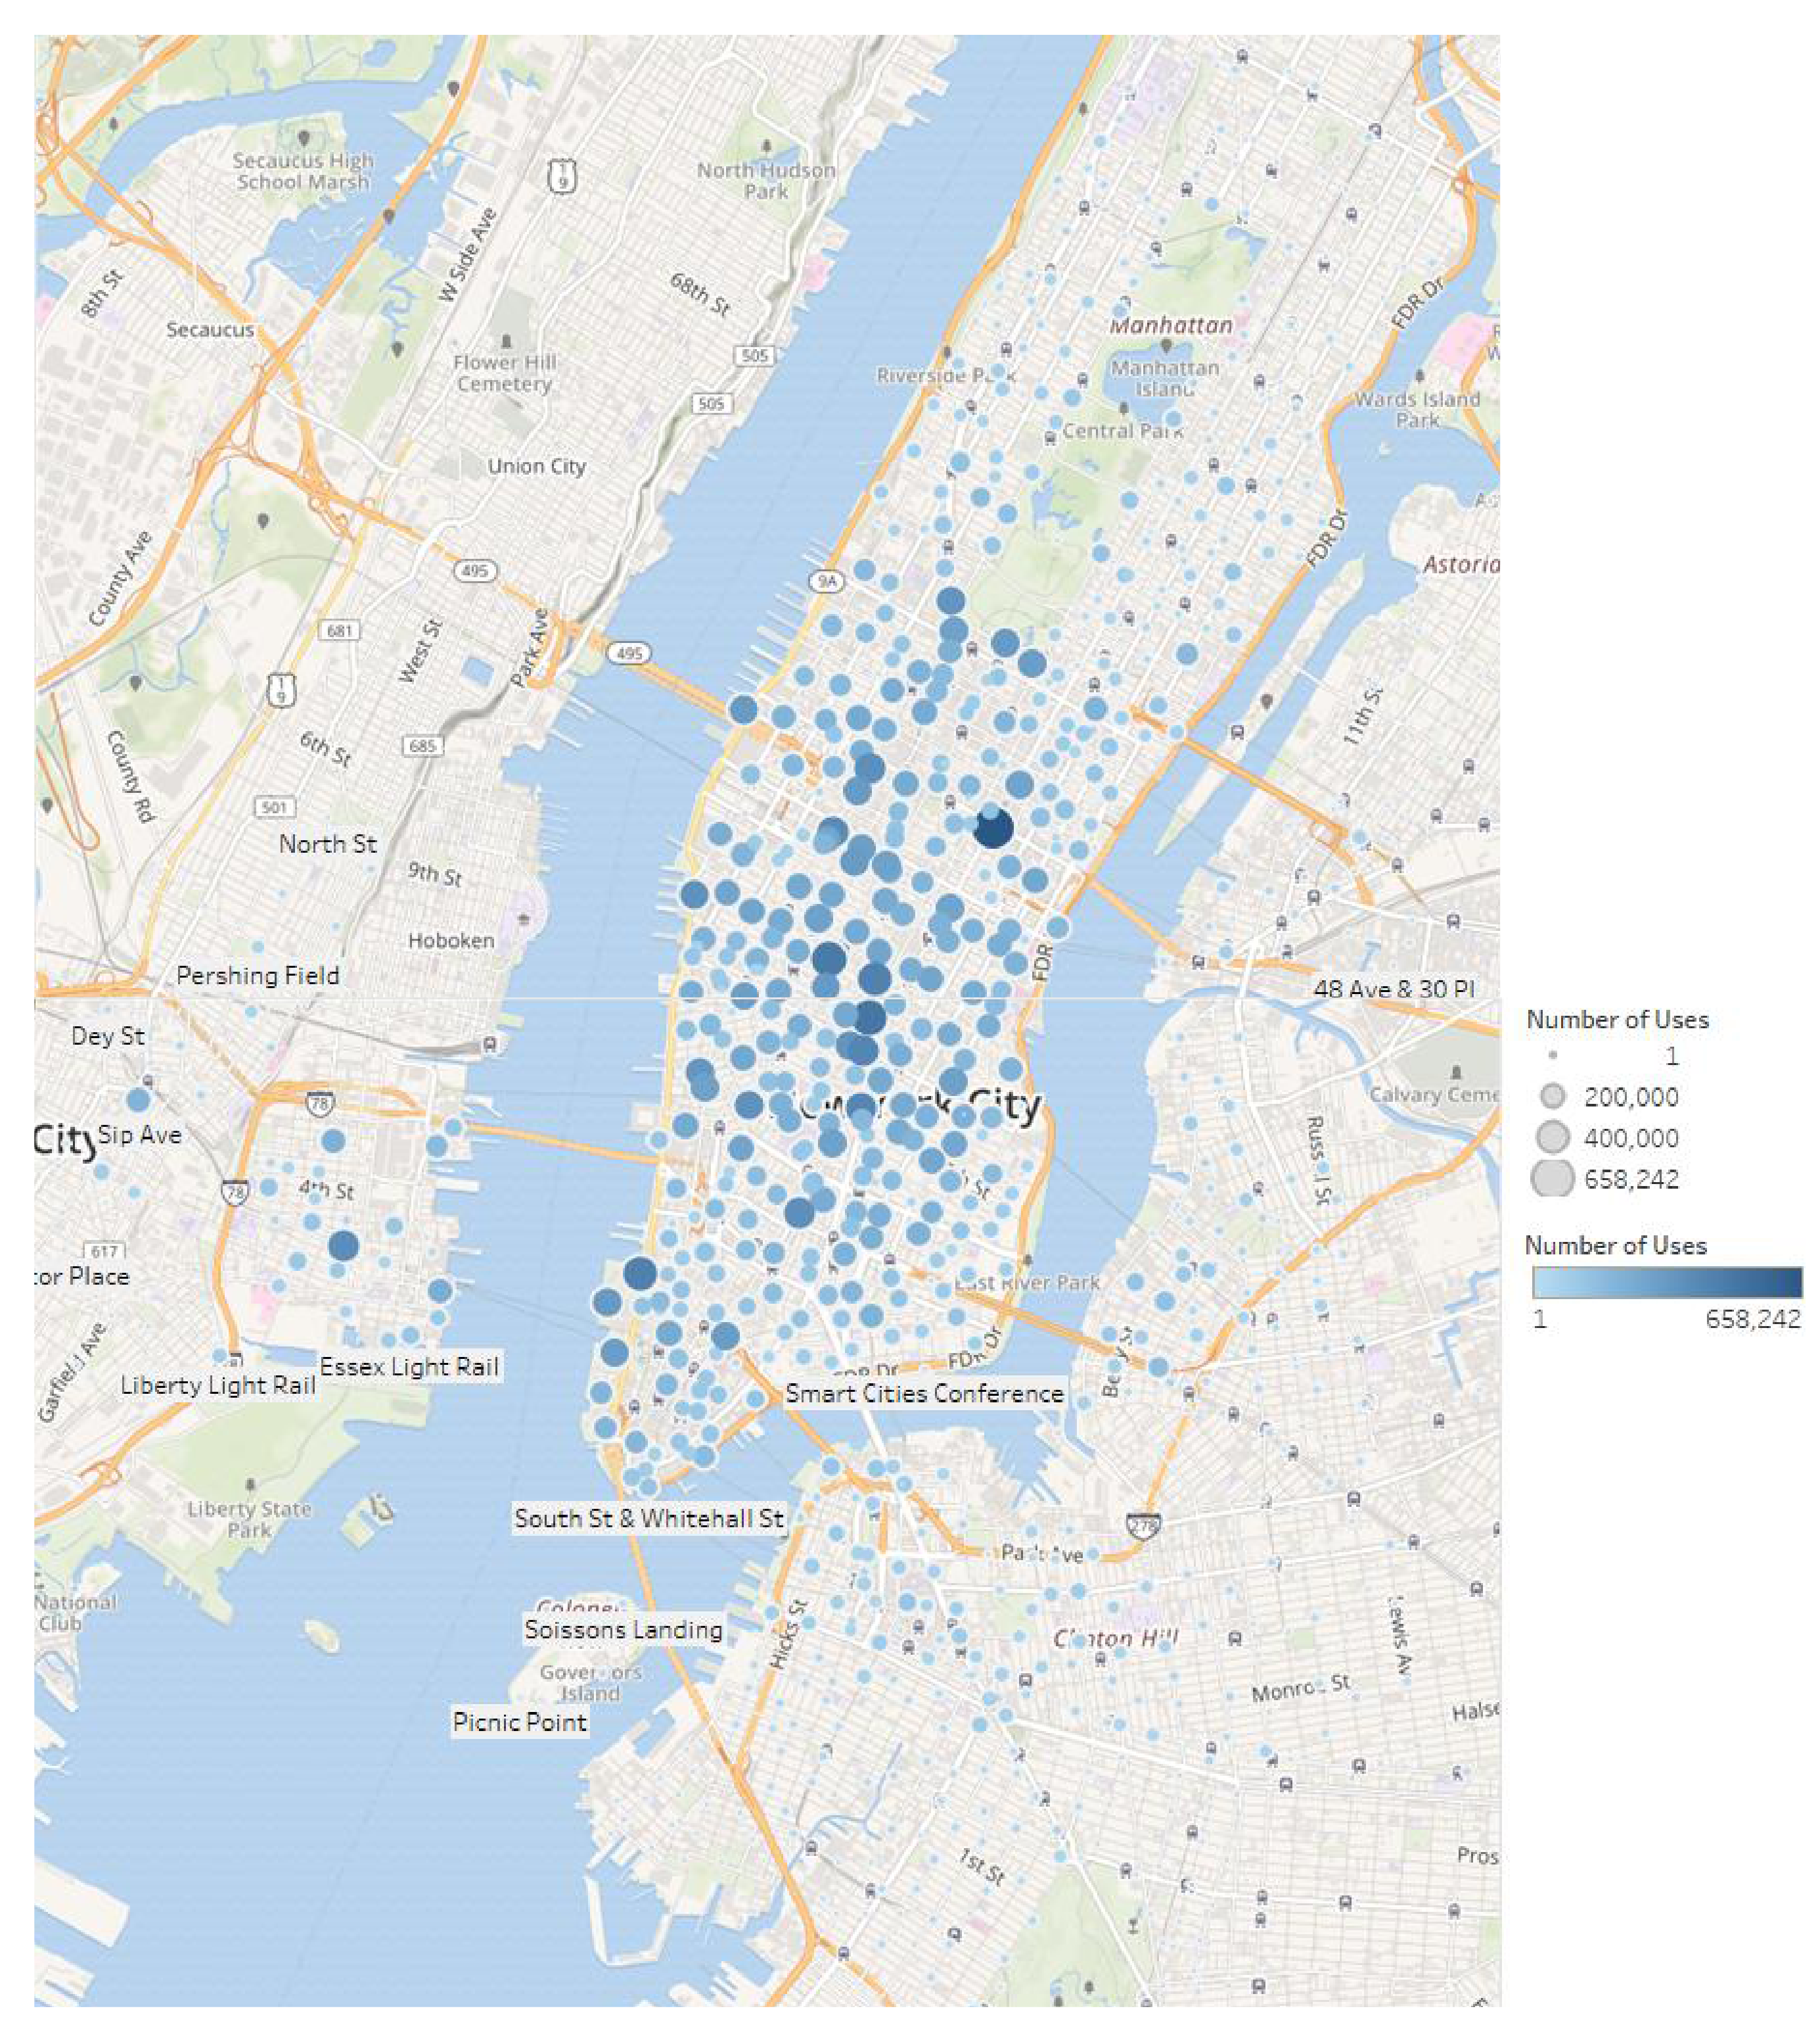
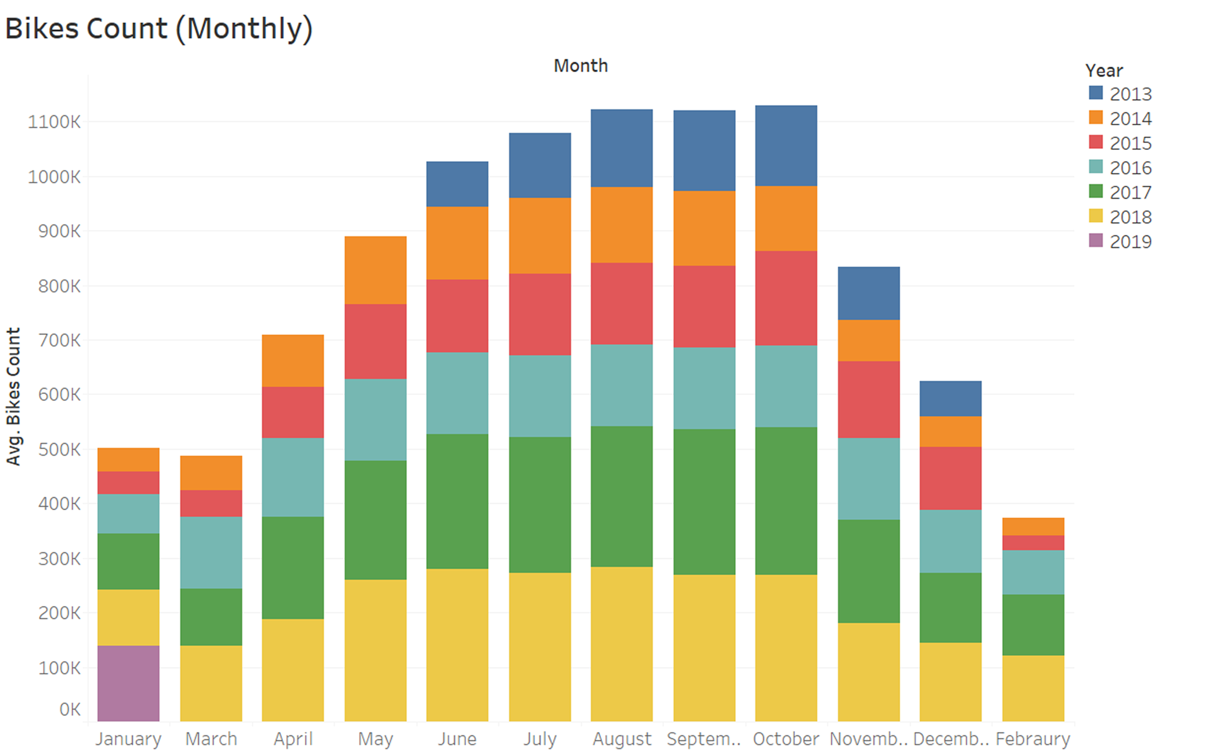
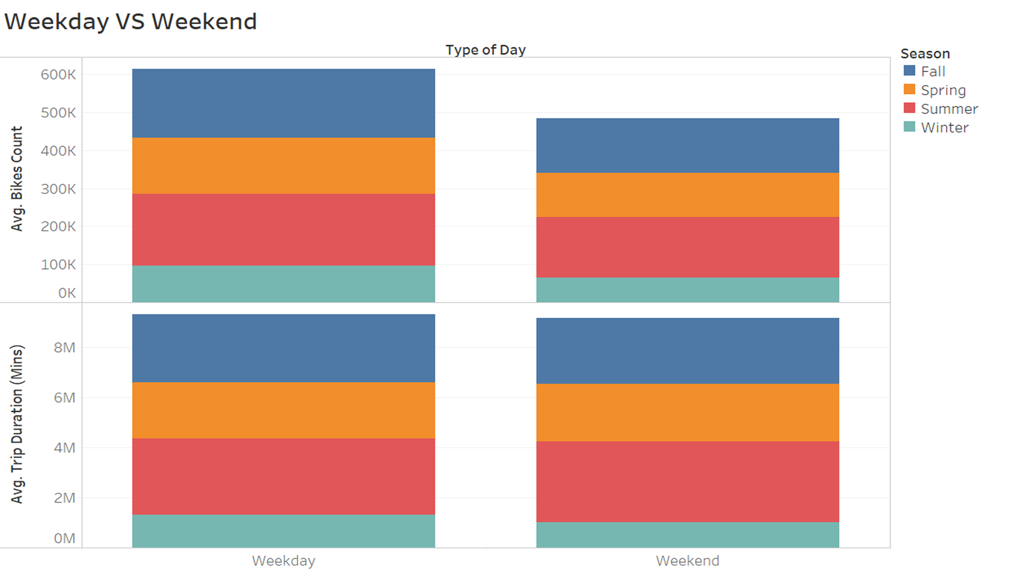
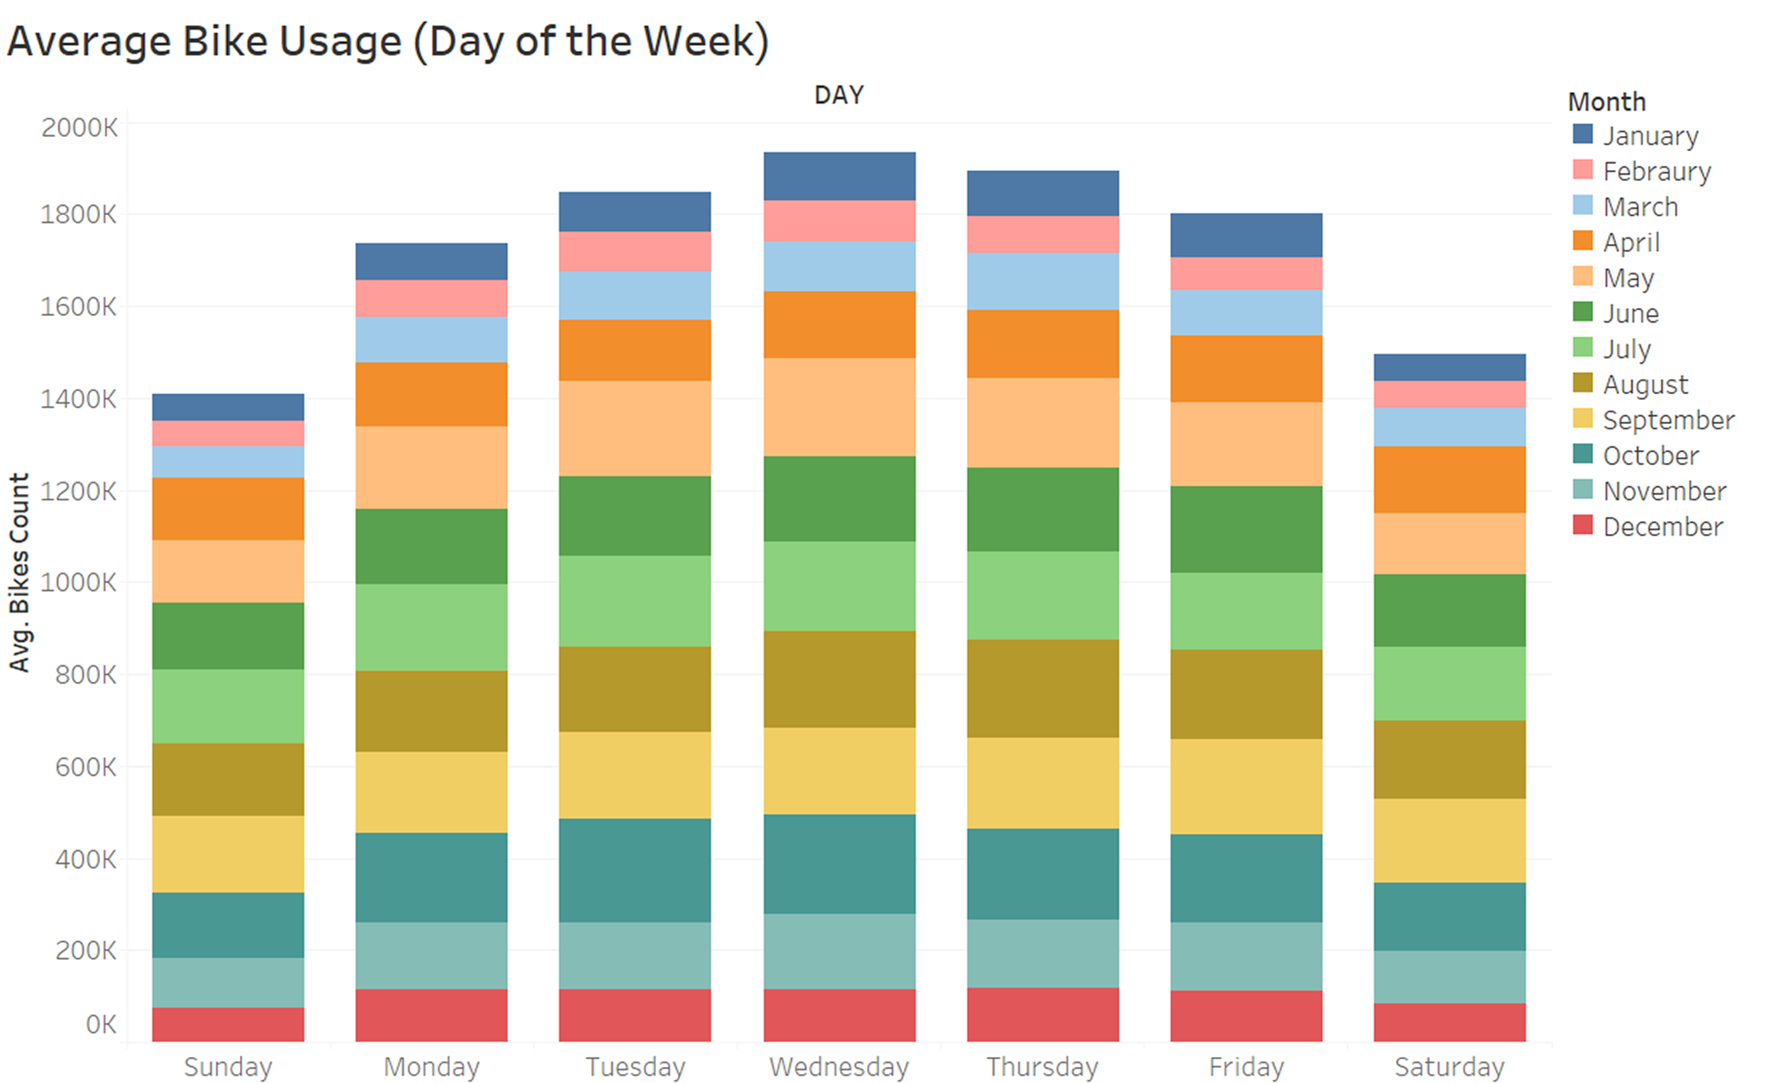
Station
Growth
Popular Start
Stations

Slide 5
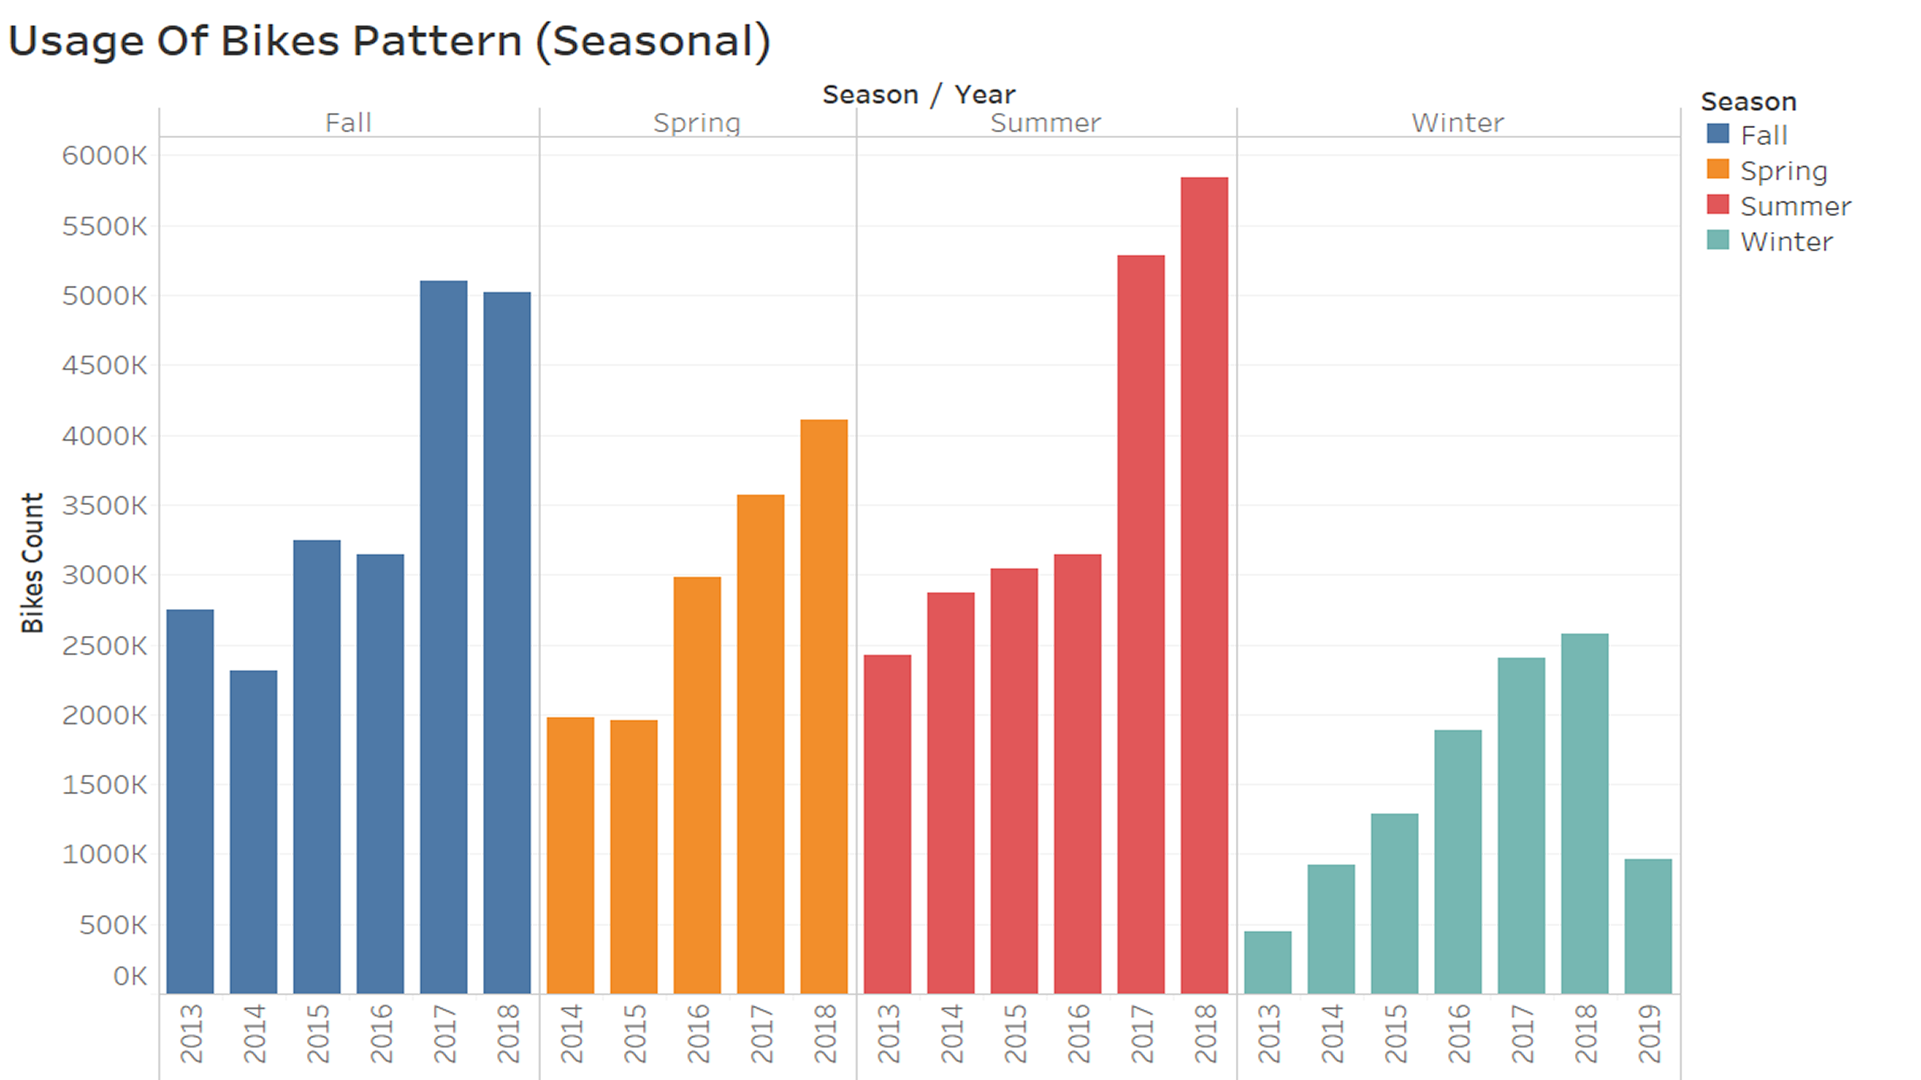
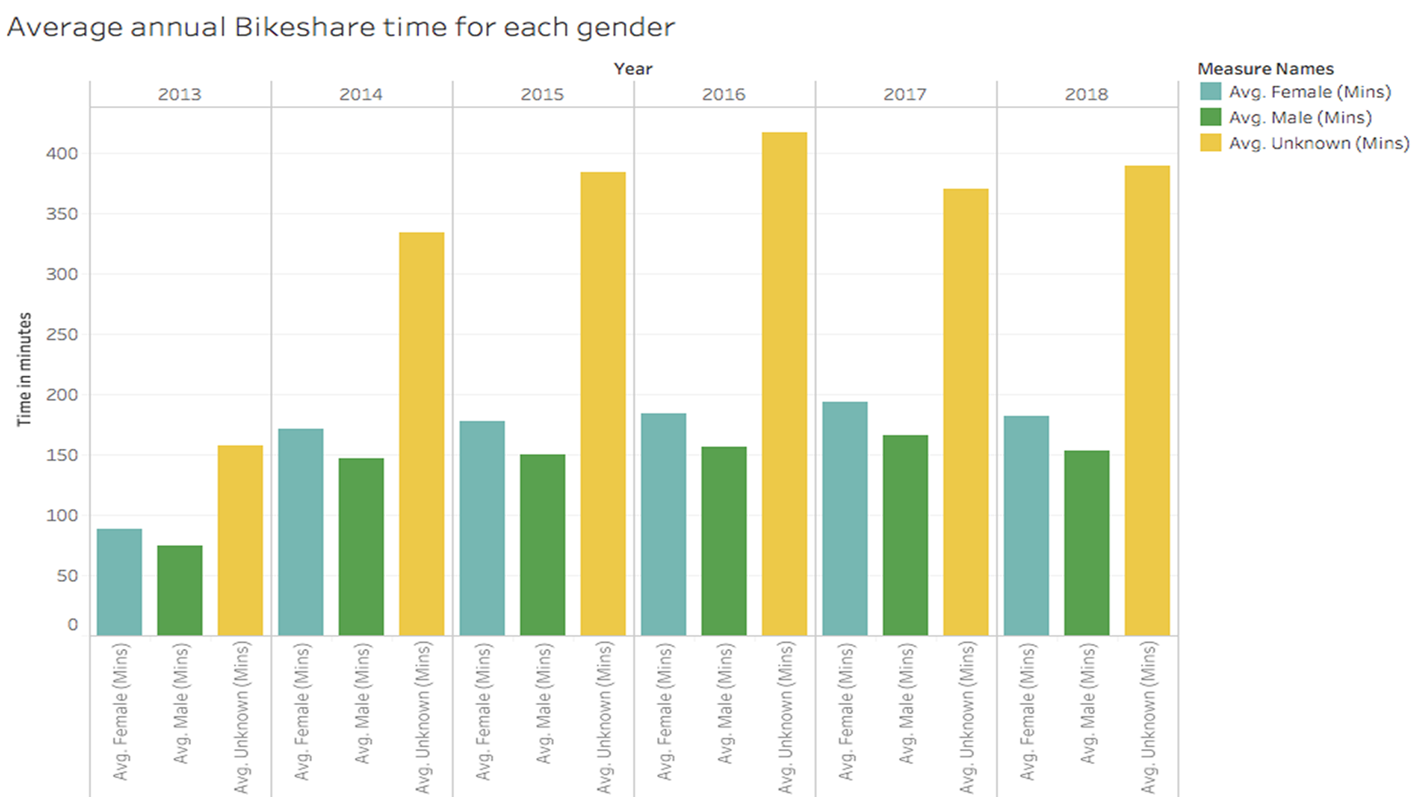
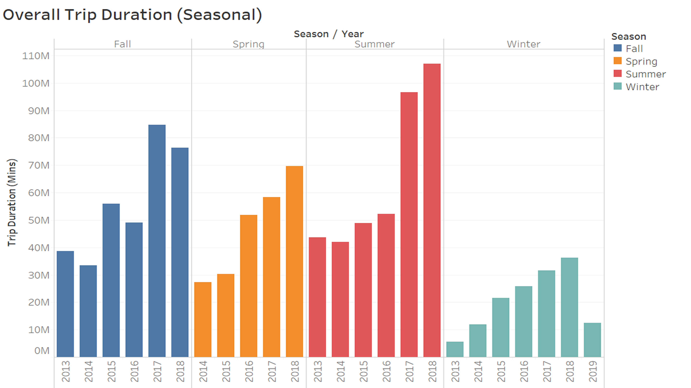
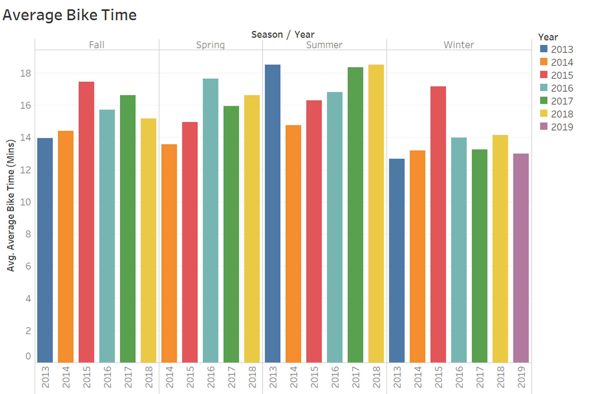

Slide 6
THANK YOU

